Slide 1
Reproductive disorder diseases
In simple language this can defined as disease affecting that lead to infertility or sterility
Fertility : ability of an animal to reproduce
Infertility : temporary inability of the animal to reproduce
Sterility : permanent inability of the animal to reproduce
Causes :
1-anatomical or structural defects (hereditary disease)
2-functinal defects(hormonal disease)
3-infectious causes
4-Managment causes

Slide 2
Hormonal infertility
1 -cystic ovaries (decrease LH)
A- follicular cysts
B- luteal cysts
C - cystic corpus luteum
2 -delayed ovulation (delayed release LH)
3 - inactive ovaries (decrease FSH)

Slide 3
Cystic ovary

Slide 4
Follicular cysts

Slide 5
Follicular cysts
Nymphomania in Follicular cysts
developed to Sterility hump

Slide 6
Follicular cysts
cystic uterine gland
hydrometra in follicular cyst

Slide 7
Follicular cysts

Slide 8
Luteal cyst
Luteal cyst
Luteal cyst

Slide 9
Luteal cyst
ovary luteal cyst
Luteal cyst developed to virilism

Slide 10
Follicular cyst luteal cyst
1- no ovulated mature follicle
2-decreas LH +++
3-frequently multiple in one or both ovaries
4-soft thin walled , fluid filled structure≥2.5 cm diameter which persist
5- affected cow will be nymphomania
6- progression to sterility hump
7-causes increase estrogen hormone
1- no ovulated mature follicle
2-deccreas LH ++
3- usually single
4- soft thick walled , fluid filled structure≥2.5 cm diameter which persist
5-Affected cow will be anestrous
6- progression to virilism
7- causes increase progesterone hormone

Slide 11
Cystic corpus luteum

Slide 12
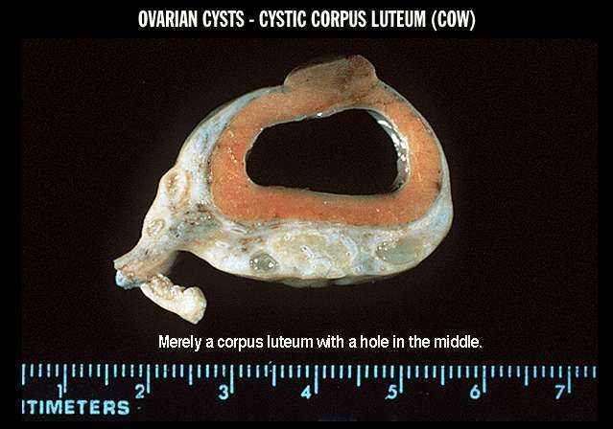

Slide 13
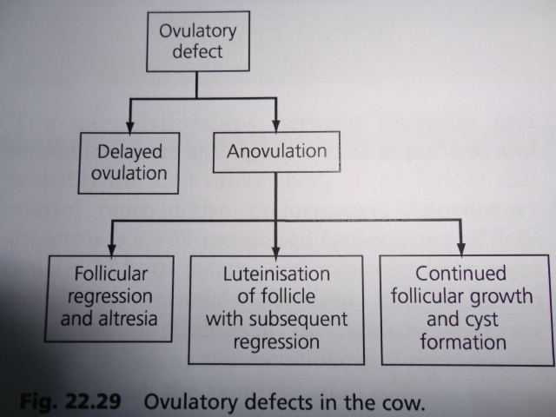
Ovulatory defect in cow

Slide 14
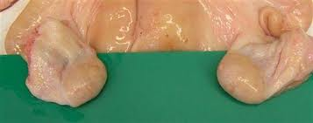
Inactive ovaries

